Slide 1
PKCE-enhanced Authorization Code
PKCE - Proof Key for Code Exchange

Slide 2
Facebook, Google, Your API
Mobile App
User
API Service
Connect to
API Service
Authorization request
Authorization Server
?response_type=code&scope={Scopes}&state={CSRF}&...
GET /authorize
?response_type=code // Required. Must be “code” &state=hv8hf0h2i7d // Recommended
&redirect_uri= {Redirect uri} // Optional
&scope={Scopes} // Optional
&client_id={Client Id} // Required
&code_challenge=-sUEoAV-txYvhniiuJ4-gwNCtsiD2XiIPvLQYm-sUsE
&code_challenge_method=S256
or “plain”
code_verifier = jWJS7olsI78LF-hcNHO1QBMqVX06iN5Z837vD6UXO3g

Slide 3
Facebook, Google, Your API
Mobile App
User
API Service
Tap
Connect to
API Service
Authorization request
Authorization Server
?response_type=code&scope={Scopes}&state={CSRF}&...
Response
http://localhost:8083/callback
?state=h4u8fF2okGBio38uE &code=b06c44f3-71be-4525-81f8-9c88472154c6.20af20a8-7146-4a97-a636-a59c784ad59b.0c9b74af-f0cb-48b8-9762-1bd23841c73a
curl --location --request POST 'http://localhost:8080/auth/realms/appsdeveloperblog/protocol/openid-connect/token' 'code=b06c44f3-71be-4525-81f8-9c88472154c6.20af20a8-7146-4a97-a636-a59c784ad59b.0c9b74af-f0cb-48b8-9762-1bd23841c73a' 'code_verifier=c3cxd2UzNHJmZGUzNHJneWh1NzhpazFxd2U0cmZkZXI1Nnl1N3lnZnJ0NmpraW85NHJkc3dlcg'

Slide 4
Request for an OAuth Code
curl --location --request GET 'http://localhost:8080/auth/realms/appsdeveloperblog/protocol/openid-connect/auth
?client_id=photo-app-pkce
&response_type=code
&scope=openid
&redirect_uri=http://localhost:8083/callback
&state=h4u8fF2okGBio38uE
&code_challenge=NDEyYjM0YzhkZTZhNWVlMzE3YWVjYmJkZWJiYTg4ZDFhMTIxNjQyMGQwZTU0NjE1NjlmZjMzNTg0NzkwODVlYQ
&code_challenge_method=S256'

Slide 5
Exchange OAuth Code for an Access Token
curl --location --request POST 'http://localhost:8080/auth/realms/appsdeveloperblog/protocol/openid-connect/token' \
--header 'Content-Type: application/x-www-form-urlencoded' \
--data-urlencode 'grant_type=authorization_code' \
--data-urlencode 'client_id=photo-app-pkce' \
--data-urlencode 'code=b06c44f3-71be-4525-81f8-9c88472154c6.20af20a8-7146-4a97-a636-a59c784ad59b.0c9b74af-f0cb-48b8-9762-1bd23841c73a' \
--data-urlencode 'redirect_uri=http://localhost:8083/callback' \
--data-urlencode 'code_verifier=c3cxd2UzNHJmZGUzNHJneWh1NzhpazFxd2U0cmZkZXI1Nnl1N3lnZnJ0NmpraW85NHJkc3dlcg'

Slide 6
Generating
Code Verifier

Slide 7
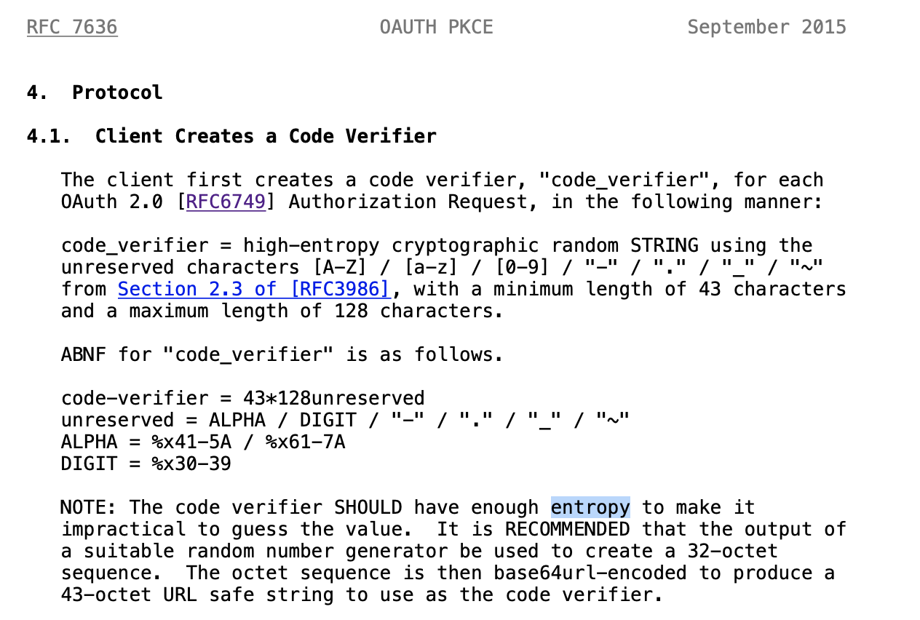

Slide 8
package com.appsdeveloperblog.pkce;
import java.io.UnsupportedEncodingException;
import java.security.MessageDigest;
import java.security.NoSuchAlgorithmException;
import java.security.SecureRandom;
import java.util.Base64;
public class PkceUtil {
String generateCodeVerifier() throws UnsupportedEncodingException {
SecureRandom secureRandom = new SecureRandom();
byte[] codeVerifier = new byte[32];
secureRandom.nextBytes(codeVerifier);
return Base64.getUrlEncoder().withoutPadding().encodeToString(codeVerifier);
}
}
5GIuDRih4mQPRoG4C4WylsHp0l--aBbOcwGO1MPEfLA

Slide 9
Generating
Code Challenge

Slide 10
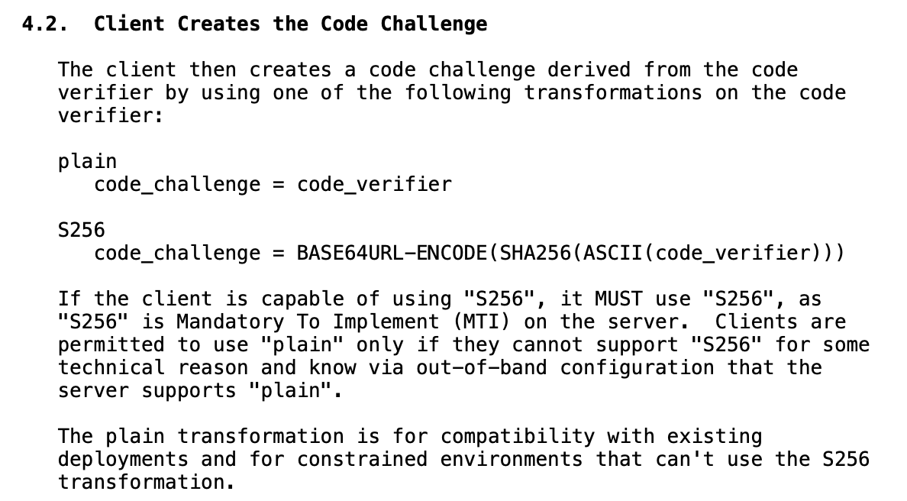
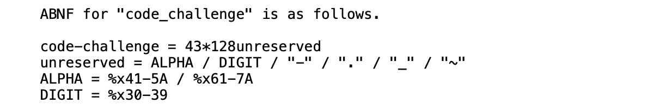
4
3
2
1

Slide 11
String generateCodeChallange(String codeVerifier) throws UnsupportedEncodingException, NoSuchAlgorithmException {
byte[] bytes = codeVerifier.getBytes("US-ASCII");
MessageDigest messageDigest = MessageDigest.getInstance("SHA-256");
messageDigest.update(bytes, 0, bytes.length);
byte[] digest = messageDigest.digest();
return Base64.getUrlEncoder().withoutPadding().encodeToString(digest);
}
ZQNn8kfypf2X6j0HFdoApXgndA1LJr2-jm6kKJgsNDQ

